Slide 1

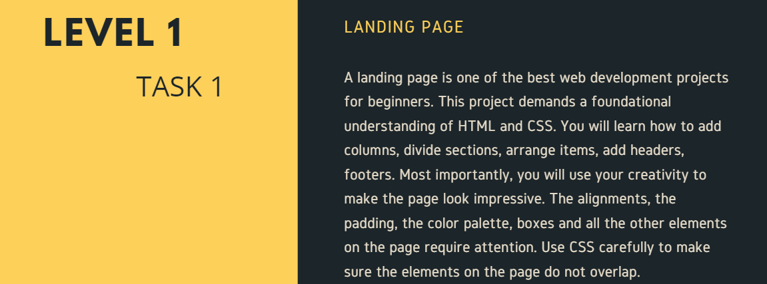
OASIS INFOBYTE
(WEB DEVELOPMENT AND DESIGNING)

